Slide 1
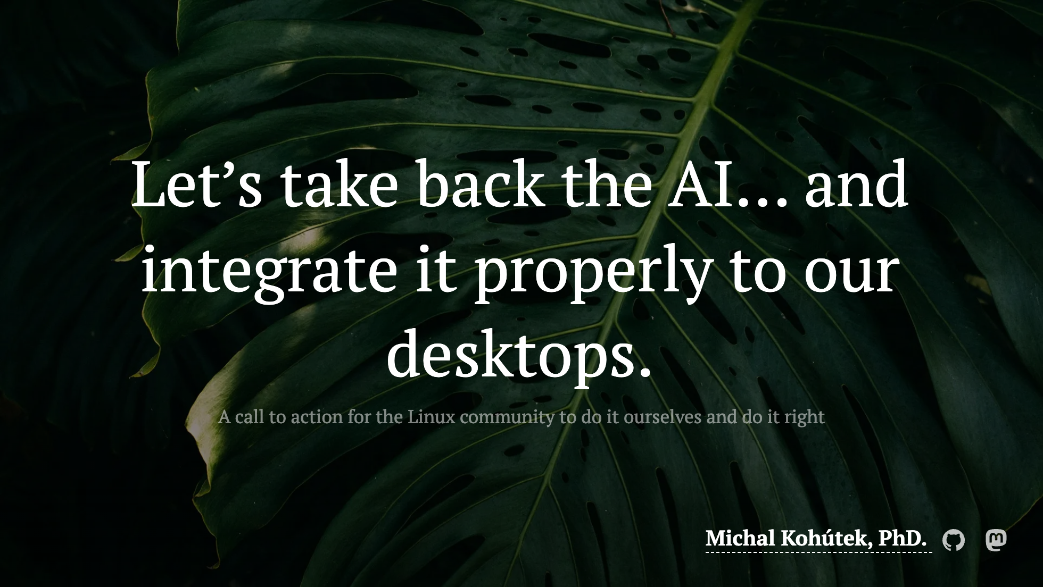
Notes:
For simplicity I will be using the term AI as a catch-all. I know some of the stuff I'm going to be talking about would be more accurately called ML, but... yeah...

Slide 2
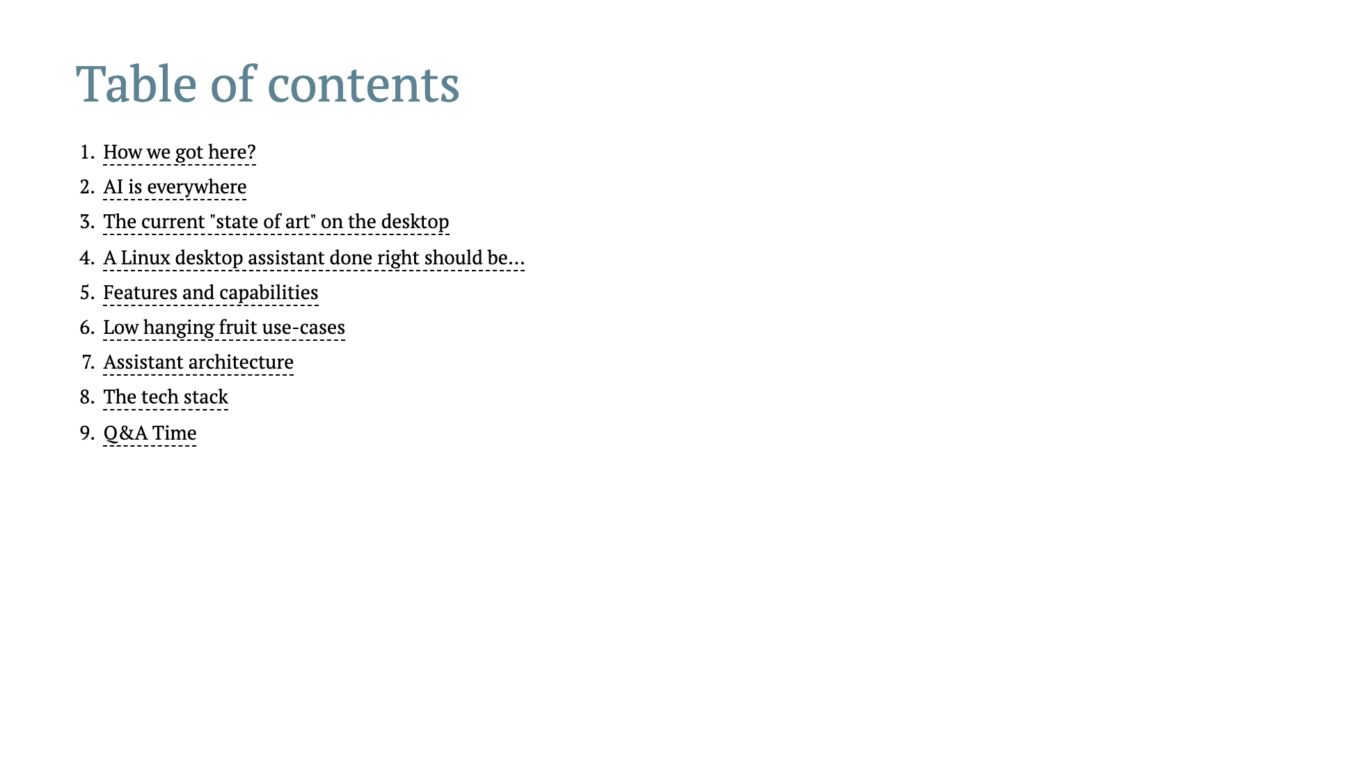

Slide 3
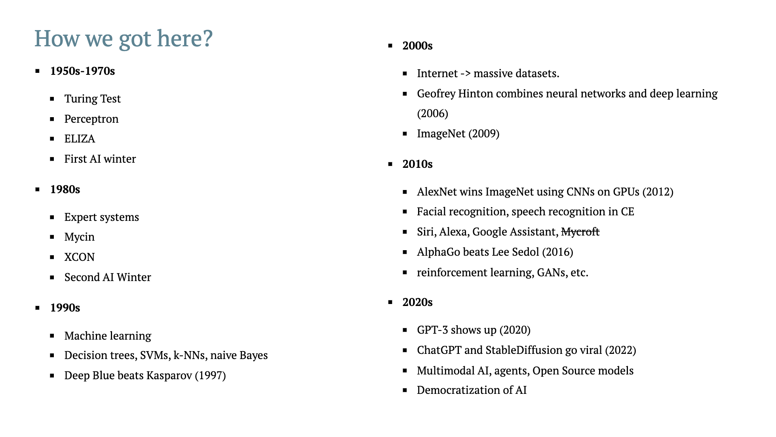
Notes:
1950s–1970s: Birth of AI
This era marks the birth of artificial intelligence as an idea. Alan Turing proposed the Turing Test to evaluate machine intelligence. The 1956 Dartmouth Conference officially launched the AI field. Early programs could simulate basic logic or conversation, but were limited by computing power and unrealistic expectations. This led to the first AI Winter when funding and interest dropped.
1980s: Expert Systems Era
AI made a comeback with expert systems—programs that used rules like “if X, then Y” to replicate expert decision-making. These were used in business and medicine. While initially successful, they couldn’t adapt or learn new knowledge, and became difficult to maintain. Overpromising led to another drop in interest, triggering the second AI Winter.
1990s: Machine Learning Awakens
Focus shifted from hardcoded rules to letting machines learn from data—this was the start of modern machine learning. Popular models like decision trees, support vector machines (SVMs), and naive Bayes became widely used. In 1997, IBM’s Deep Blue defeated chess champion Garry Kasparov, showing AI could master complex tasks.
2000s: Big Data and Deep Learning Foundations
The internet created huge datasets, and computing power improved. This fueled machine learning. In 2006, Geoffrey Hinton introduced deep belief networks, reviving interest in deep learning. Around 2009, the ImageNet dataset was launched—over 14 million labeled images that became a turning point in computer vision research.
2010s: Deep Learning Revolution
Deep learning took off after AlexNet crushed the ImageNet challenge in 2012 using GPUs and convolutional neural networks. AI powered tools like Siri, Google Translate, and facial recognition. In 2016, AlphaGo beat a world champion at Go—once thought to be beyond AI’s reach. Deep learning became the dominant technique across industries.
2020s: Generative AI and Foundation Models
AI became part of daily life. GPT-3 (2020) showed powerful language generation. In 2022, ChatGPT made AI widely accessible. Tools like DALL·E and Stable Diffusion could generate realistic images from text. These large models—called foundation models—can perform many tasks across domains. Since 2023, we’ve seen the rise of open-source LLMs, multi-modal AI, and AI agents that can plan and act. AI is now embedded in everyday tools and workflows.
Quick Definitions (if needed during Q&A)
Decision Tree: A model that splits data into branches based on simple yes/no questions—like a flowchart.
SVM (Support Vector Machine): Finds the best boundary that separates categories in the data.
Naive Bayes: A simple, probability-based model that’s great for tasks like spam filtering.
Deep Belief Network: An early form of deep learning with stacked layers that learn increasingly complex patterns from data.

Slide 4
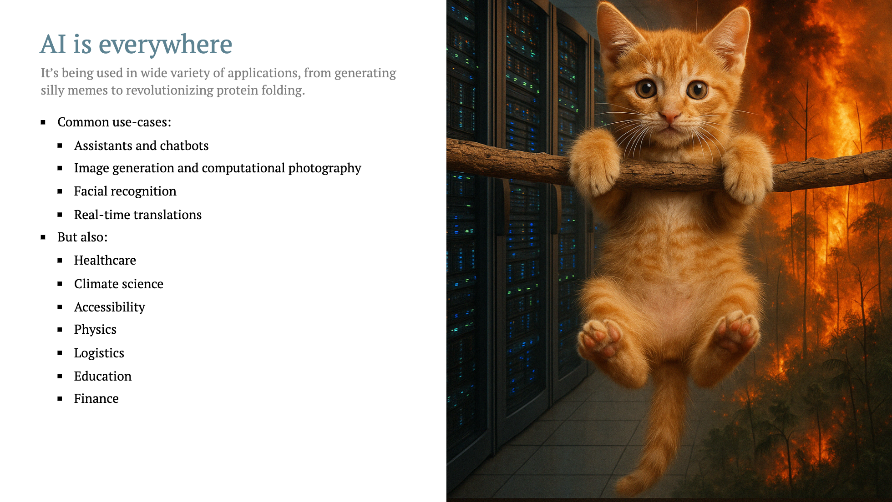

Slide 5
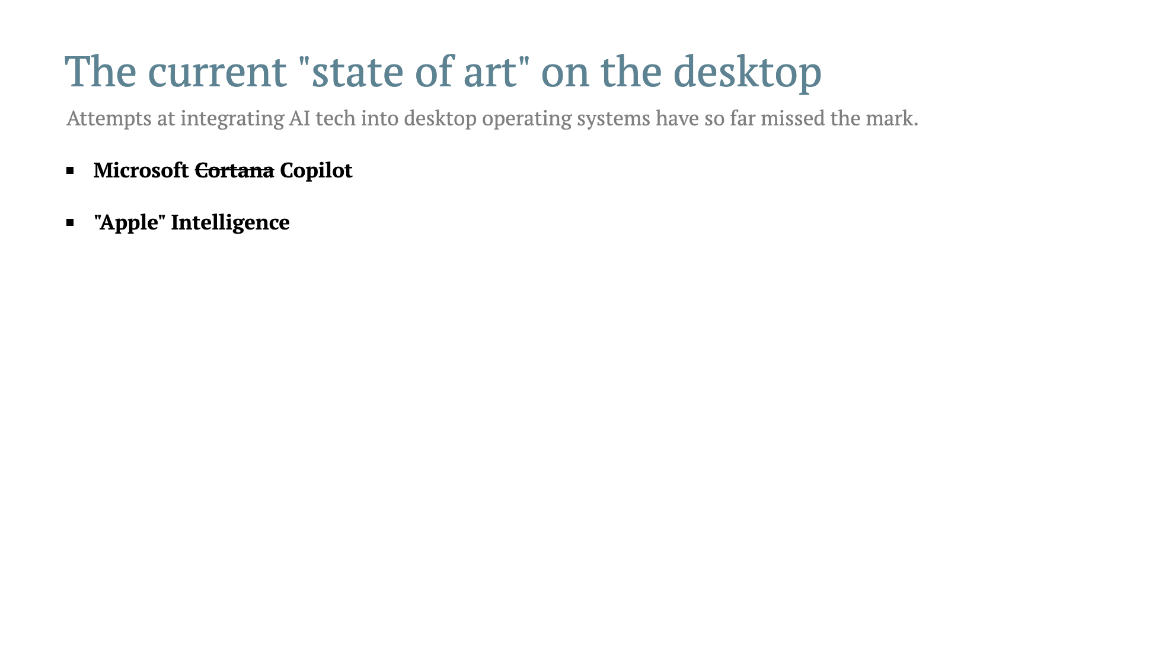
Notes:
<video v-click autoplay loop style="height: 240px;">
<source src="./img/thanos.mp4" type="video/mp4">
</video>

Slide 6
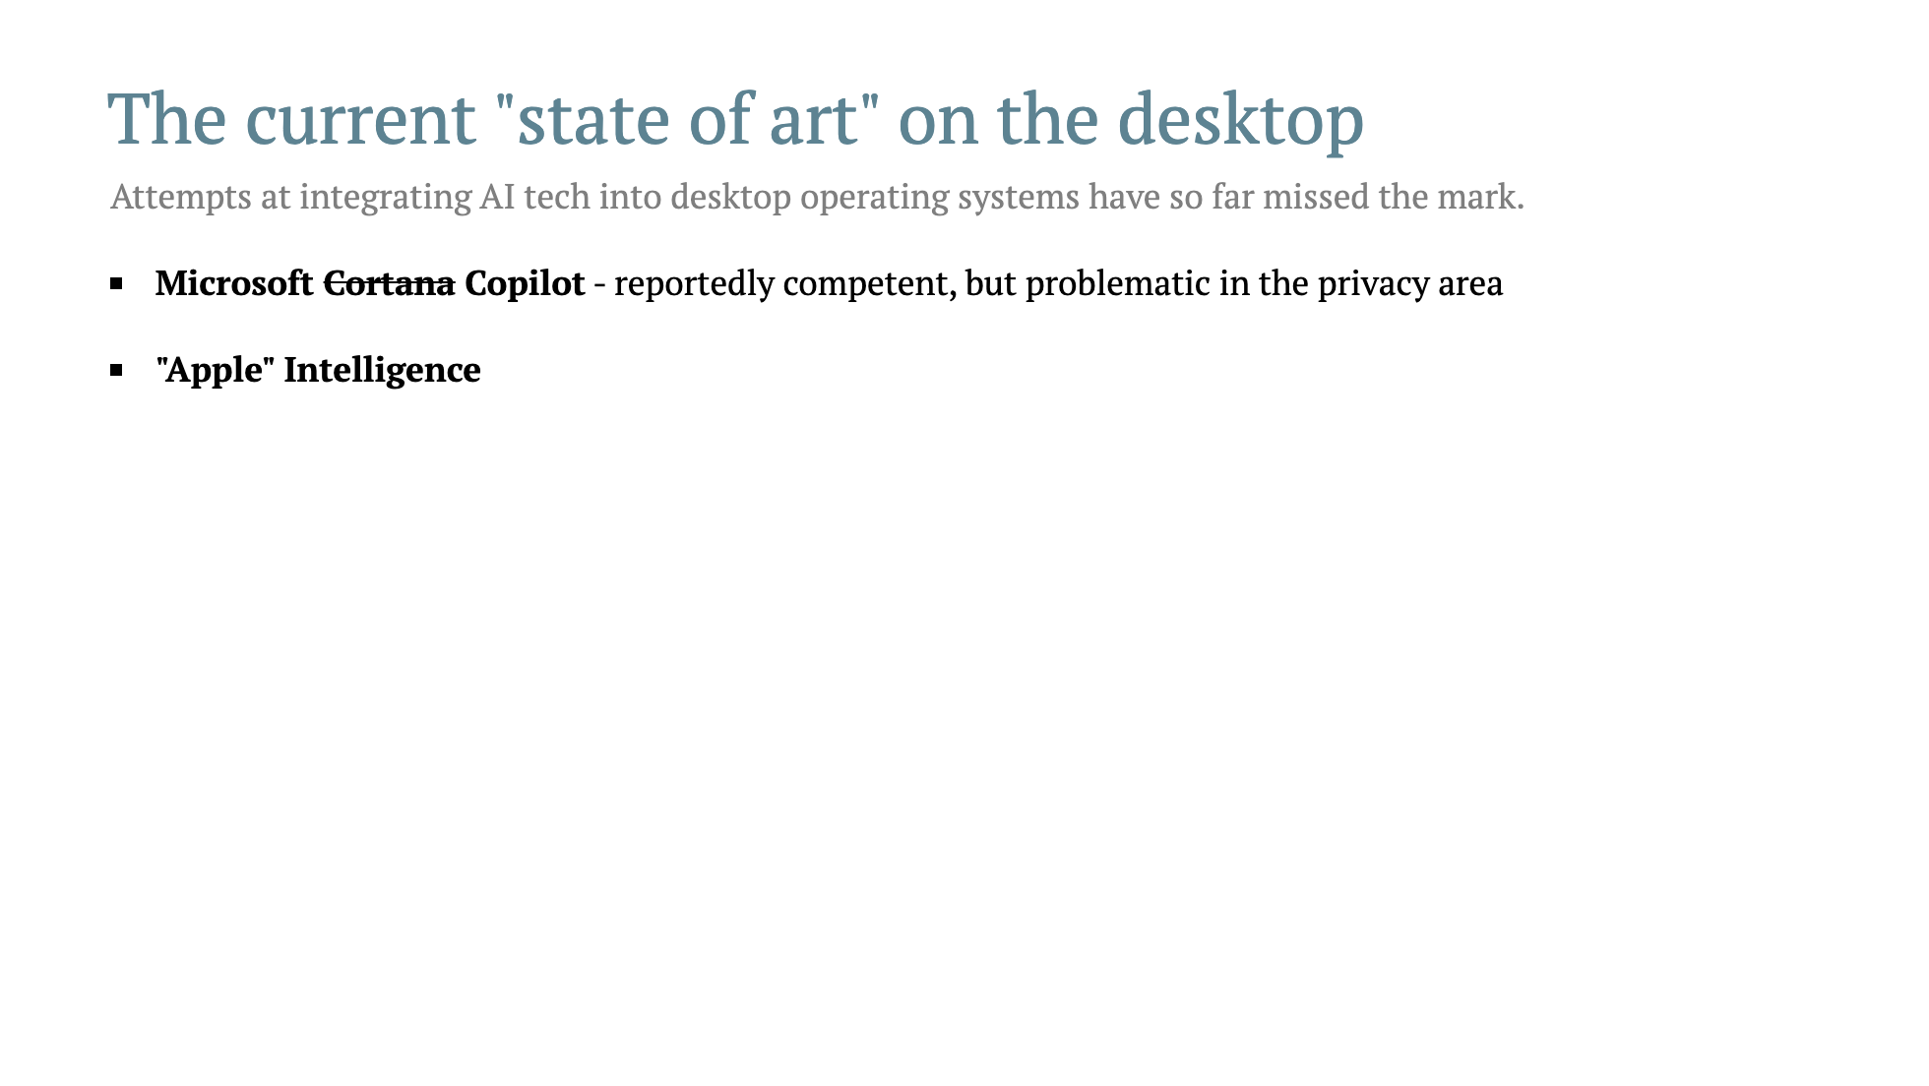
Notes:
<video v-click autoplay loop style="height: 240px;">
<source src="./img/thanos.mp4" type="video/mp4">
</video>

Slide 7
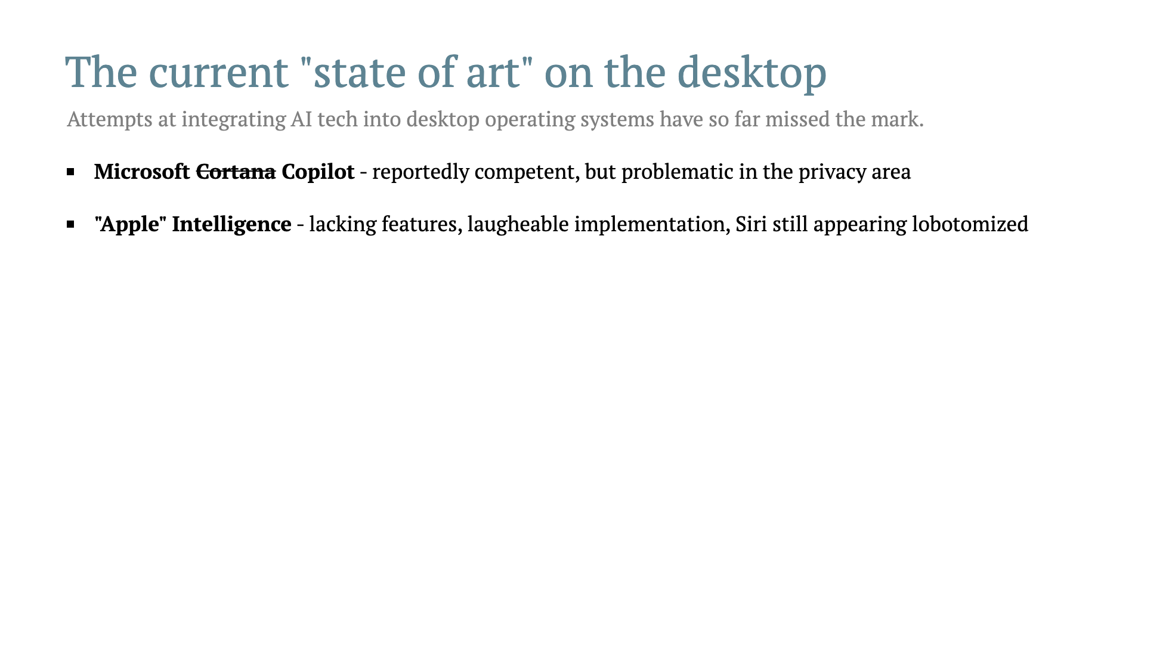
Notes:
<video v-click autoplay loop style="height: 240px;">
<source src="./img/thanos.mp4" type="video/mp4">
</video>

Slide 8
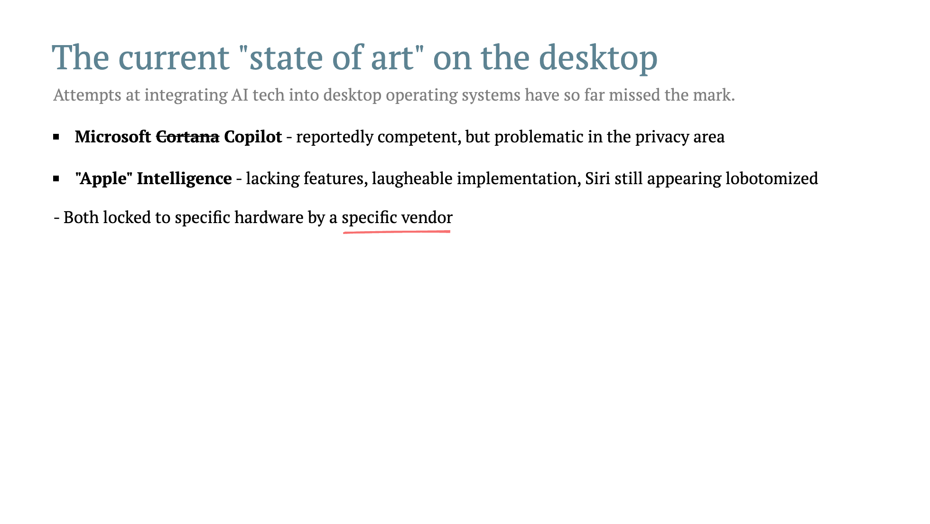
Notes:
<video v-click autoplay loop style="height: 240px;">
<source src="./img/thanos.mp4" type="video/mp4">
</video>

Slide 9
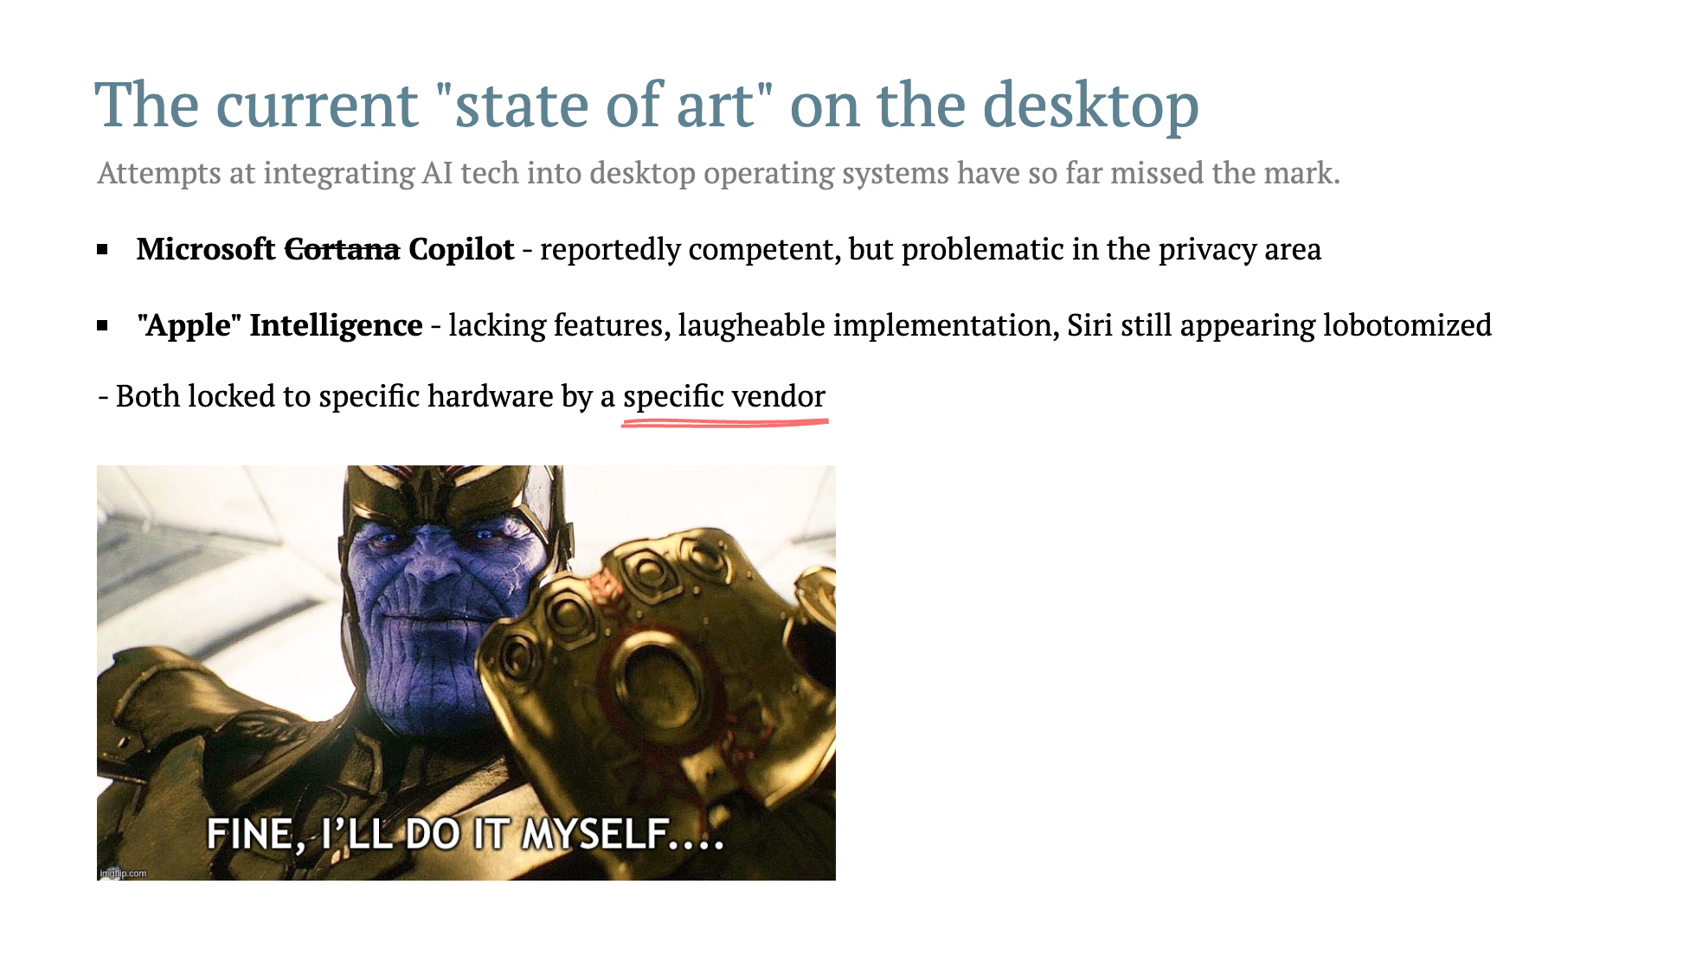
Notes:
<video v-click autoplay loop style="height: 240px;">
<source src="./img/thanos.mp4" type="video/mp4">
</video>

Slide 10
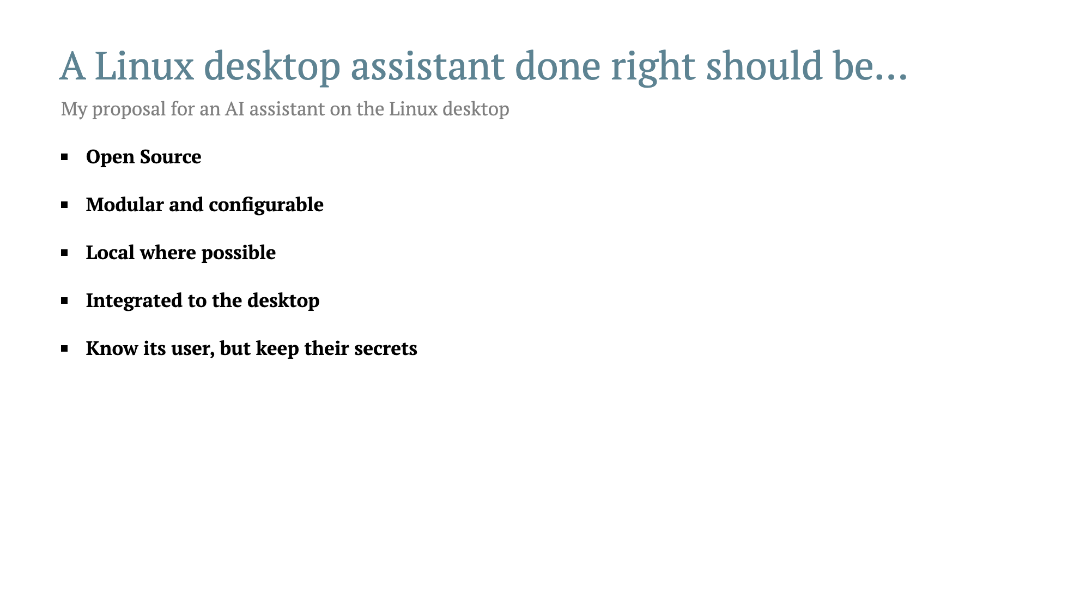

Slide 11
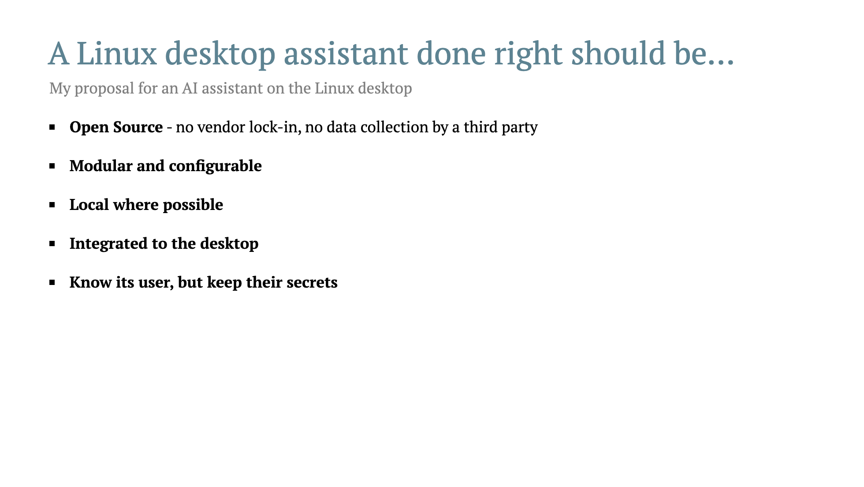

Slide 12
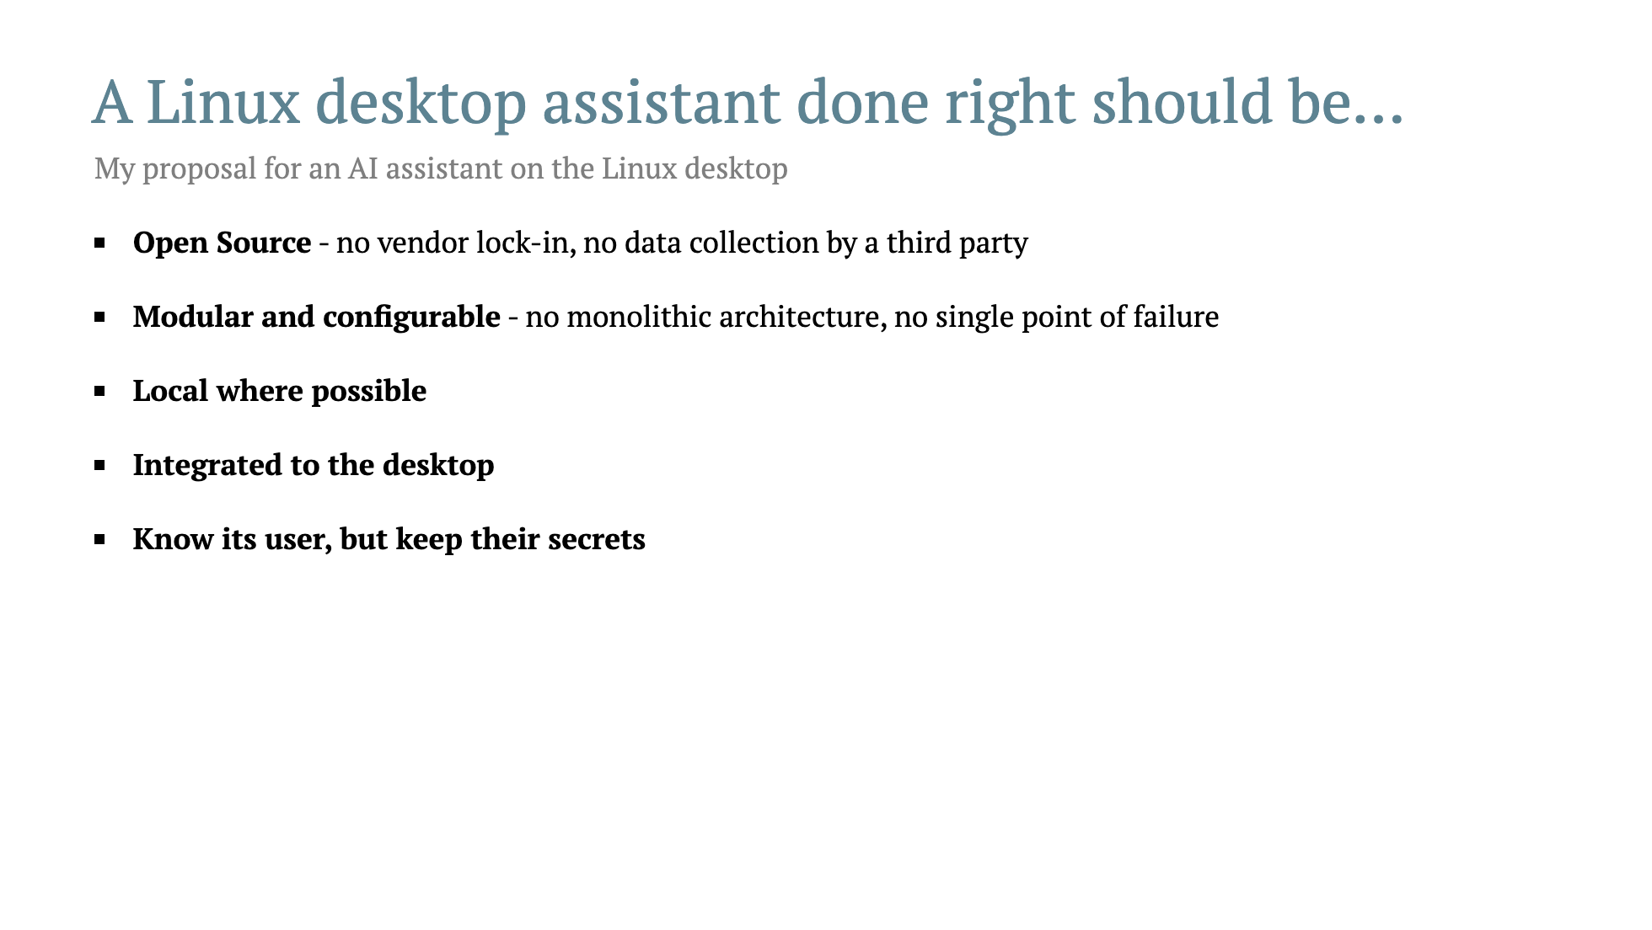

Slide 13
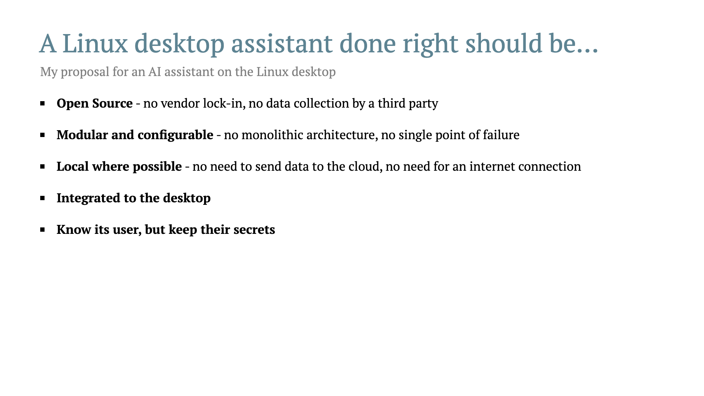

Slide 14
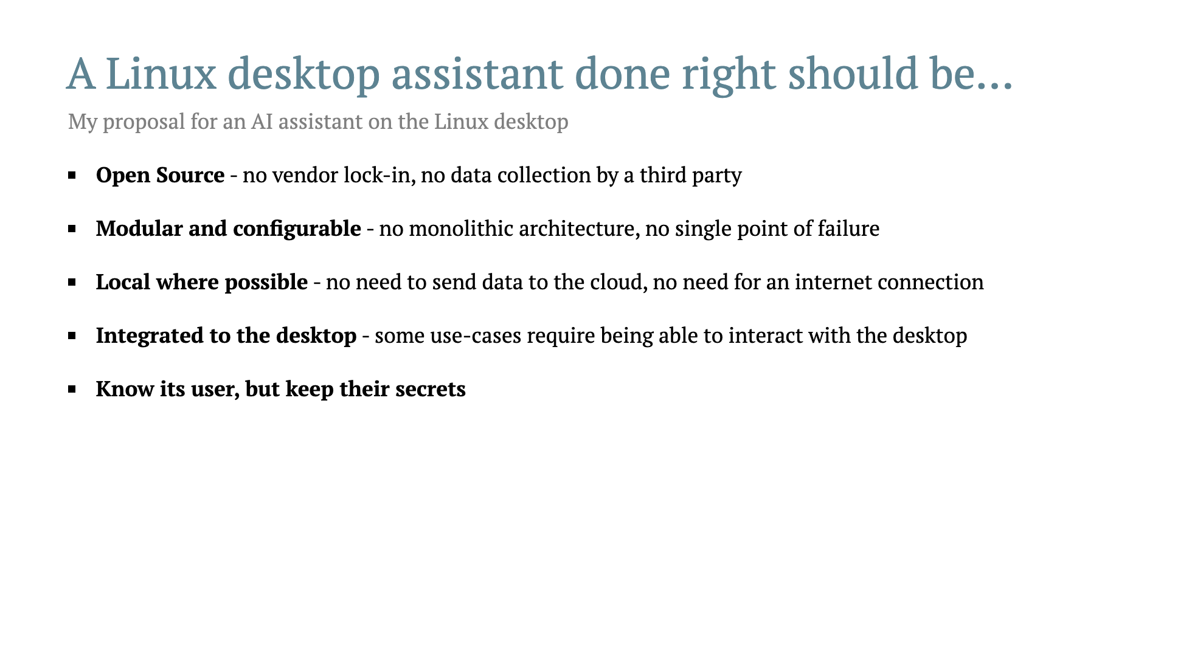

Slide 15
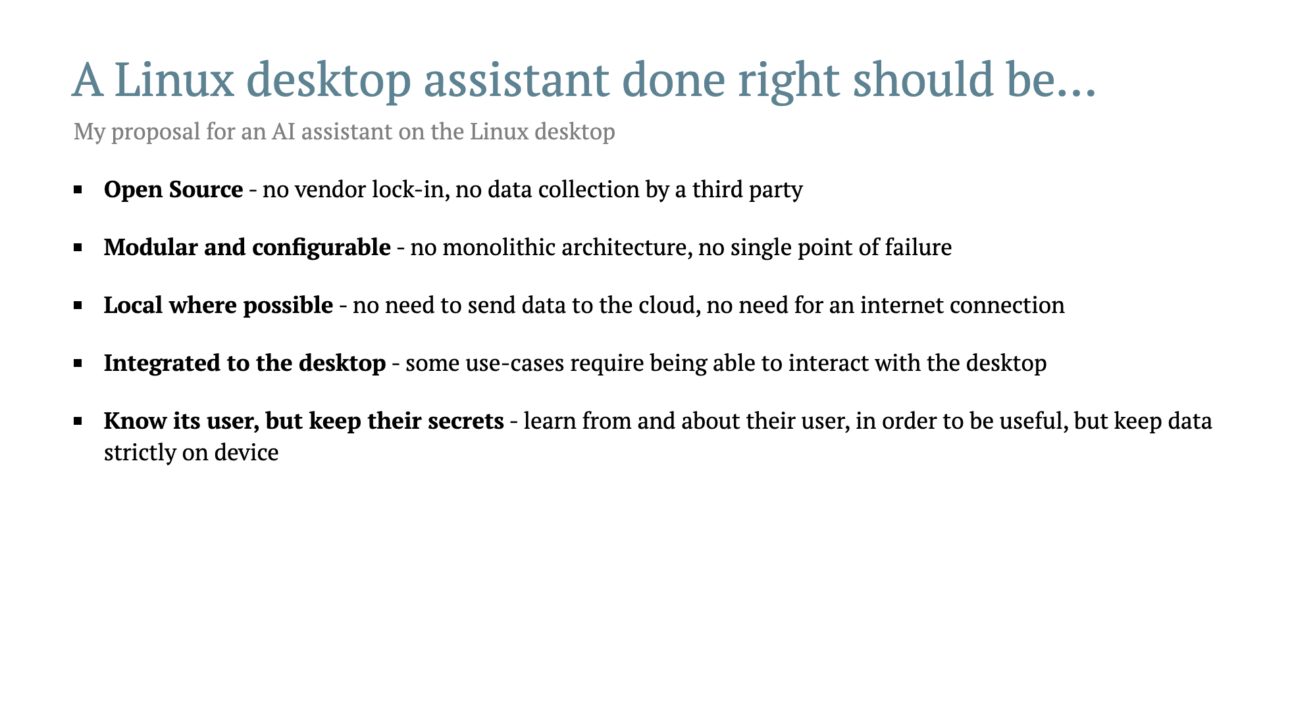

Slide 16
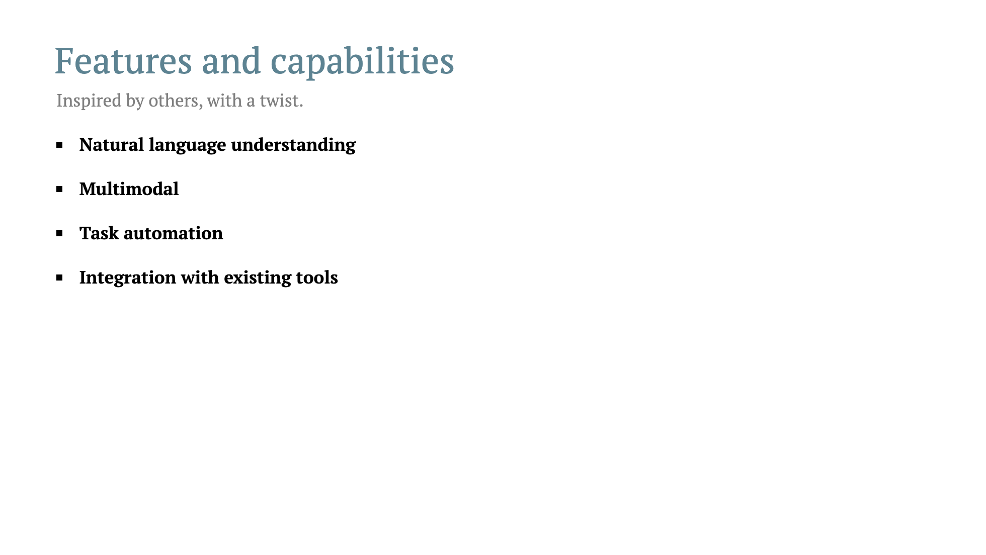

Slide 17
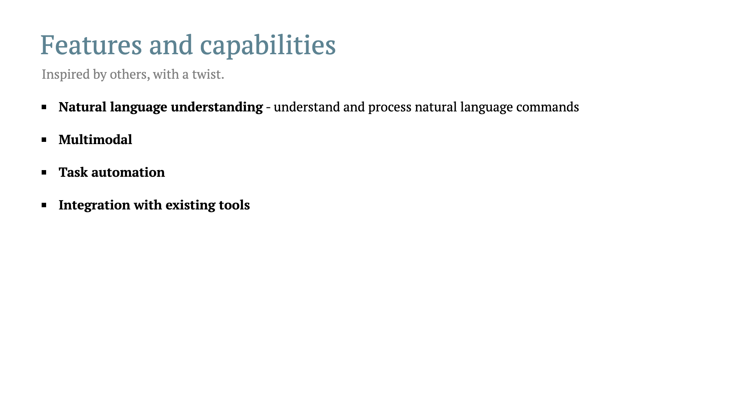

Slide 18
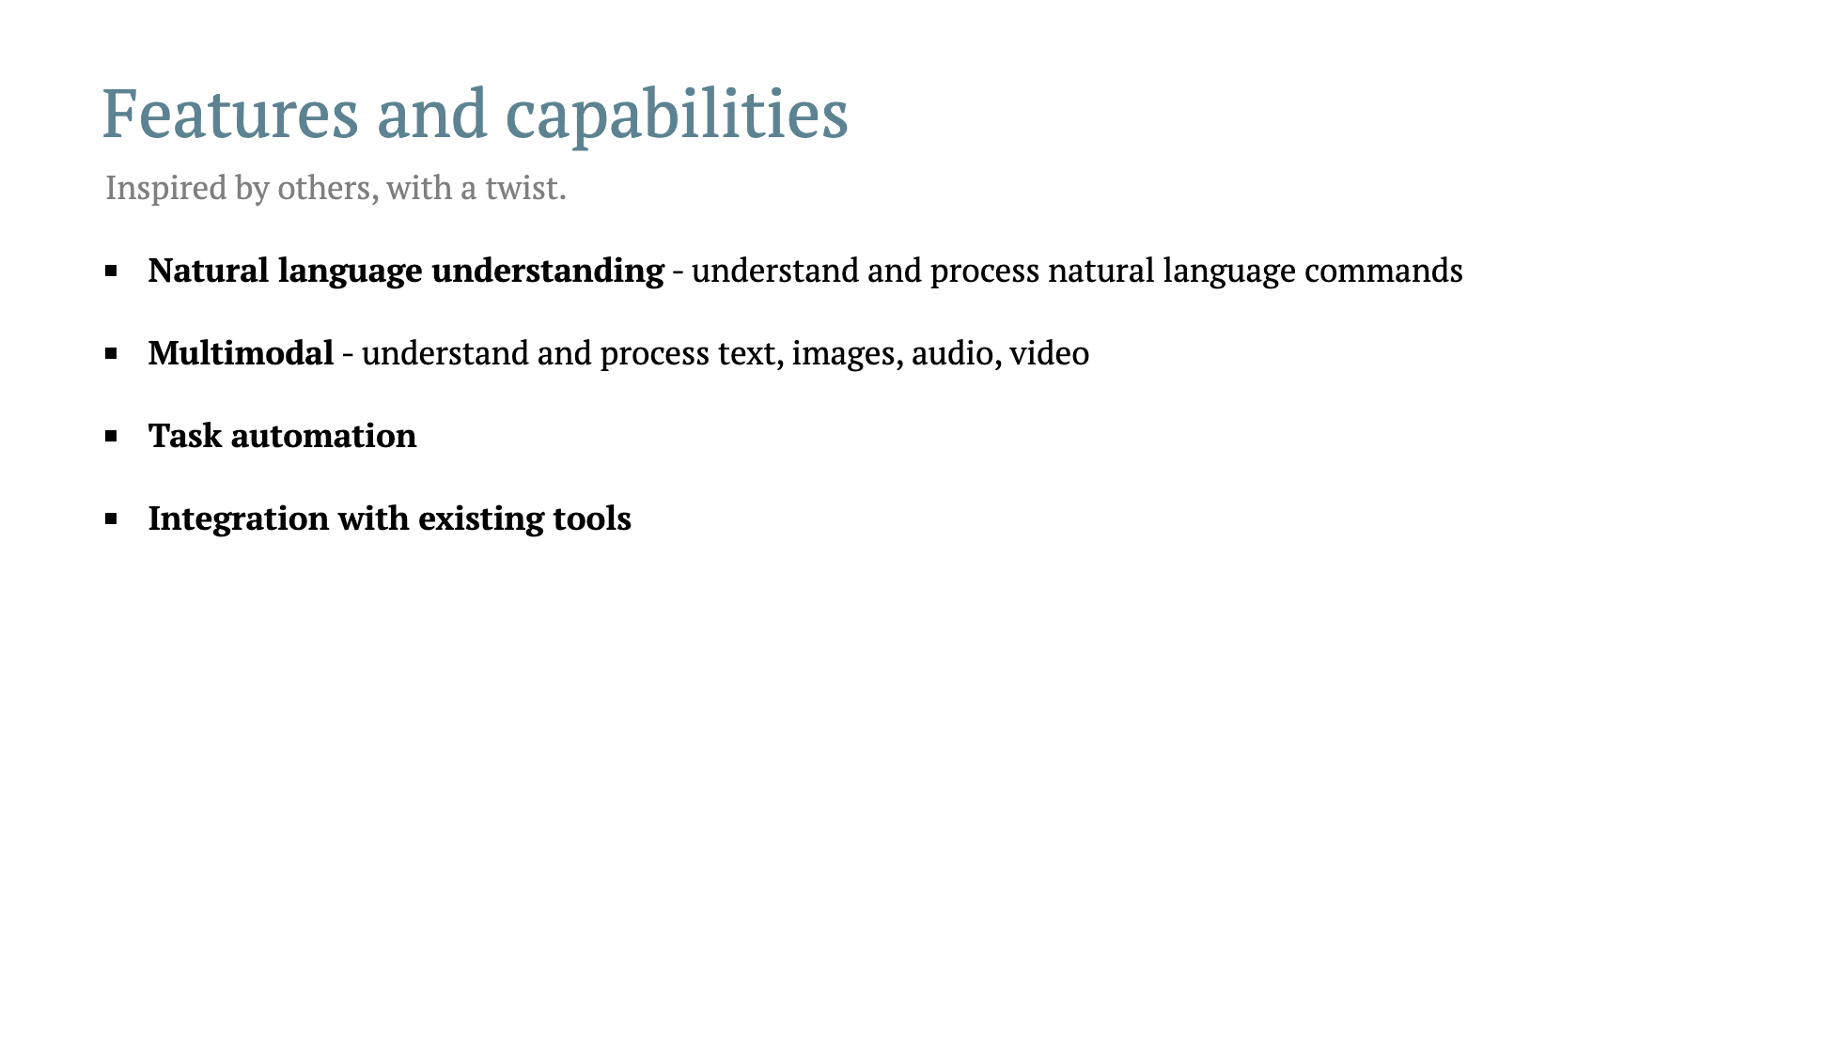

Slide 19
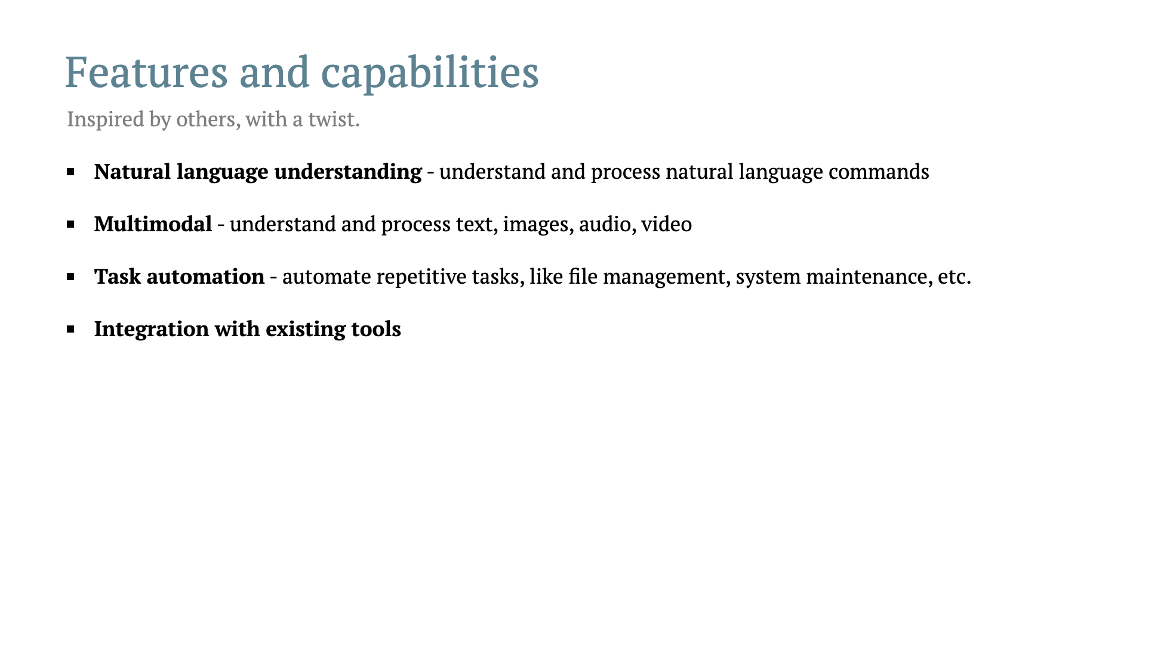

Slide 20
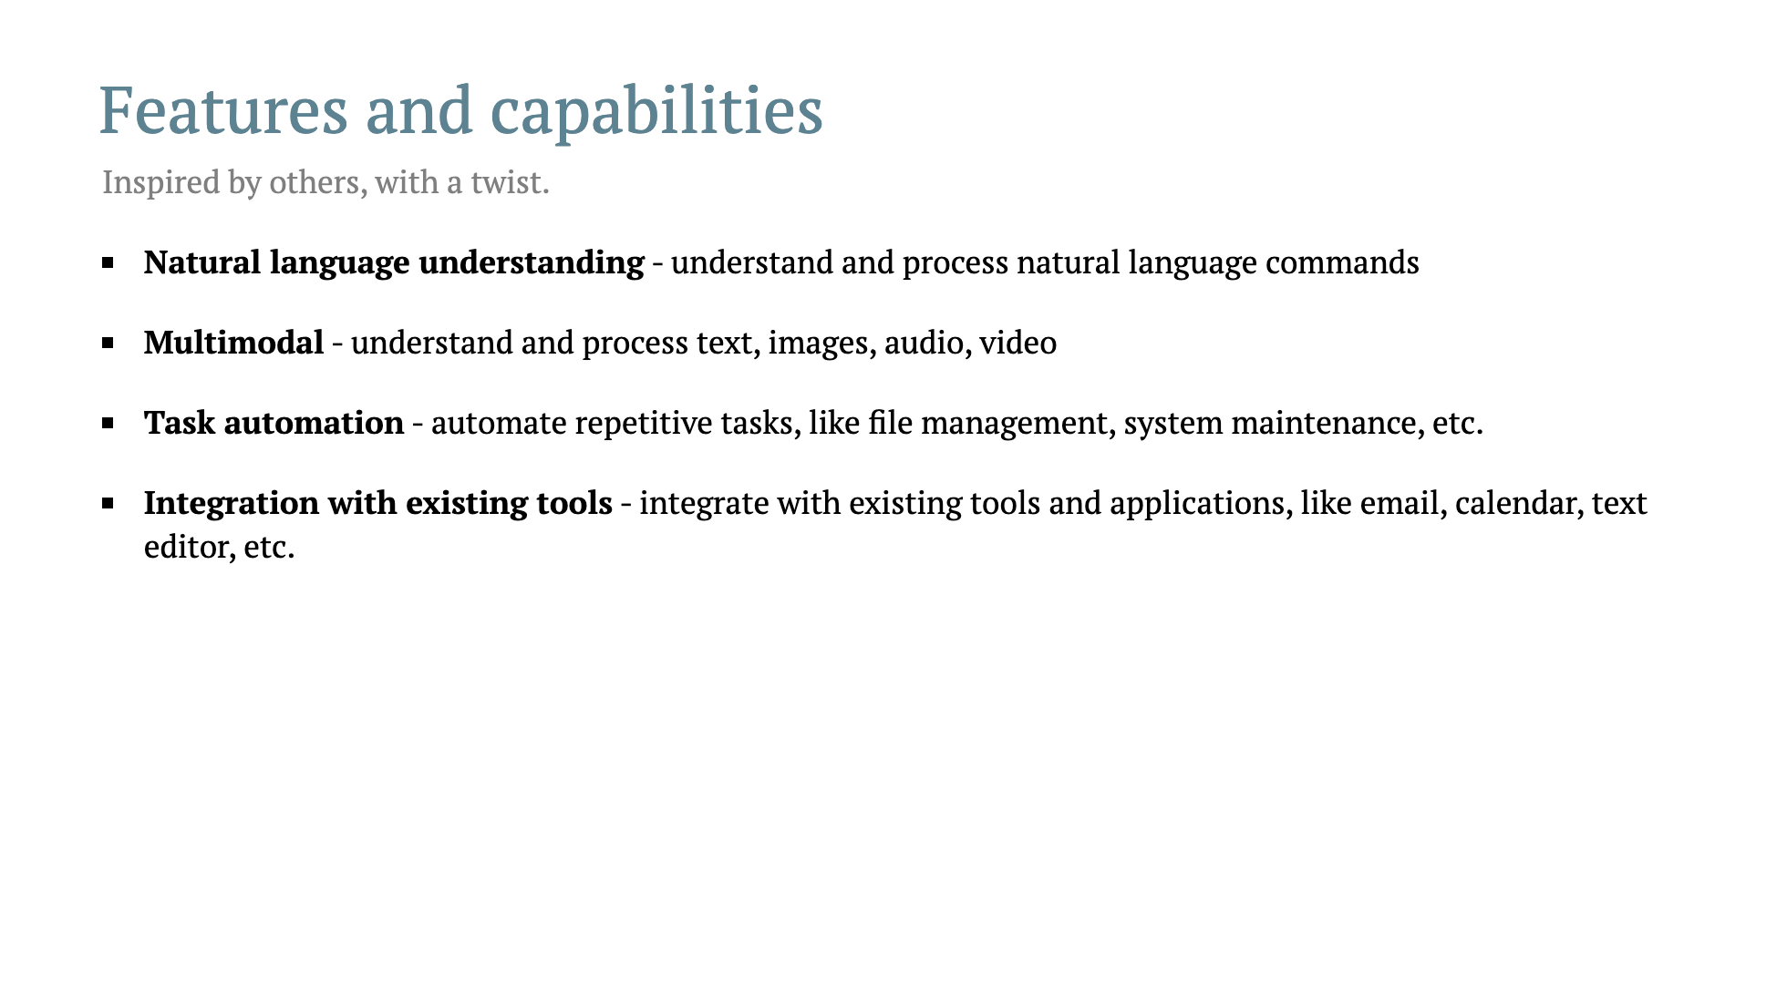

Slide 21
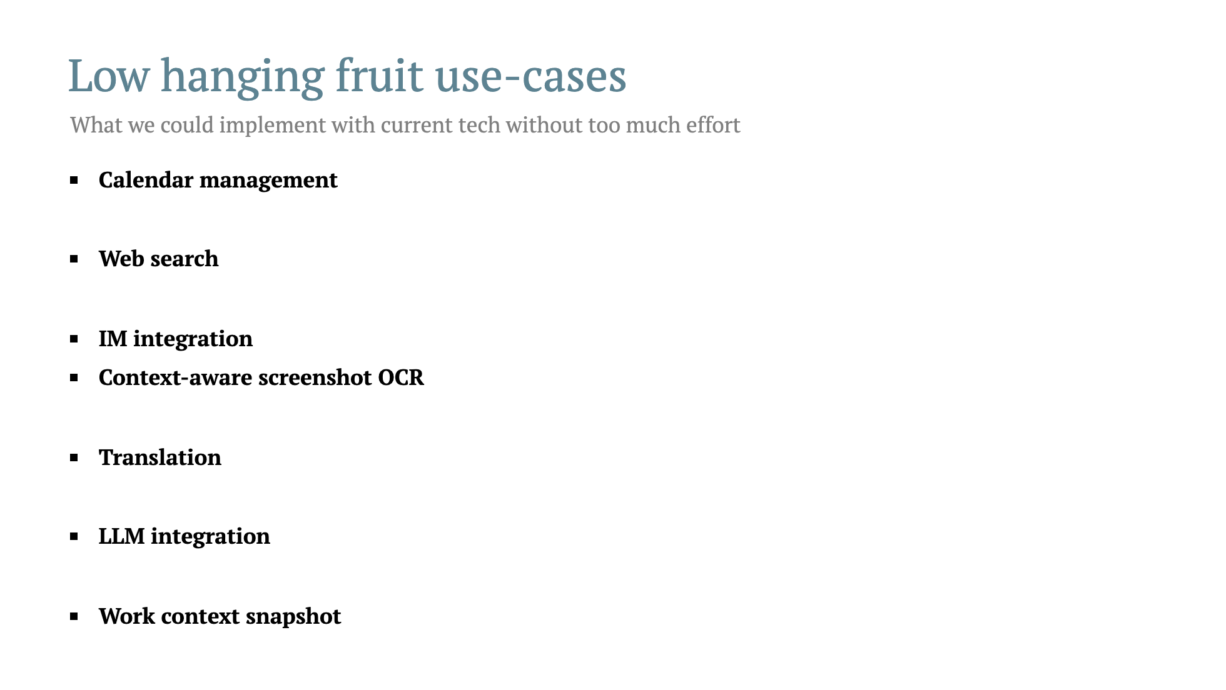

Slide 22
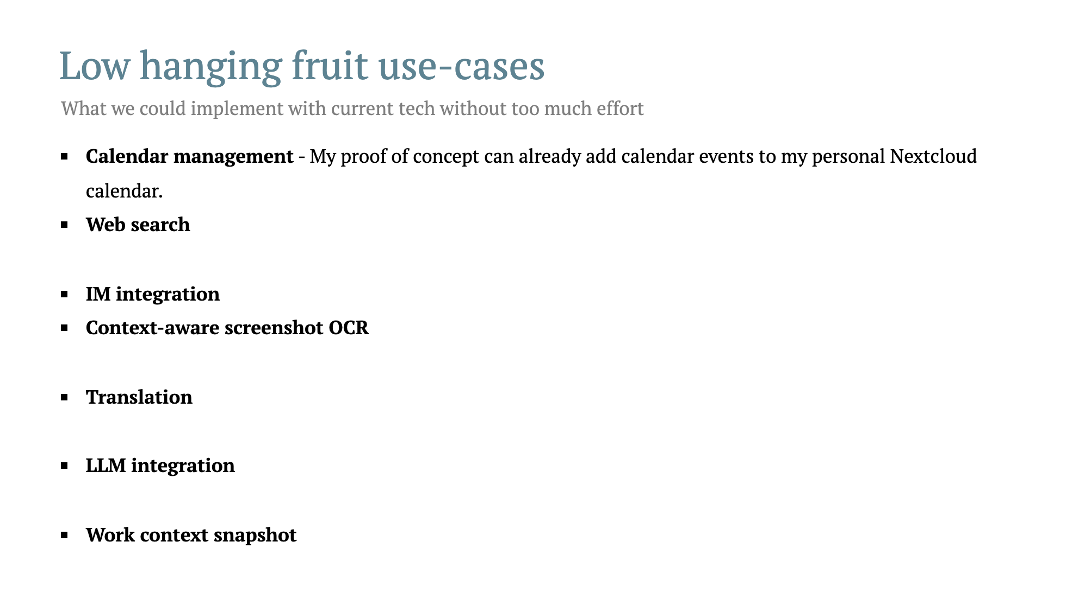

Slide 23
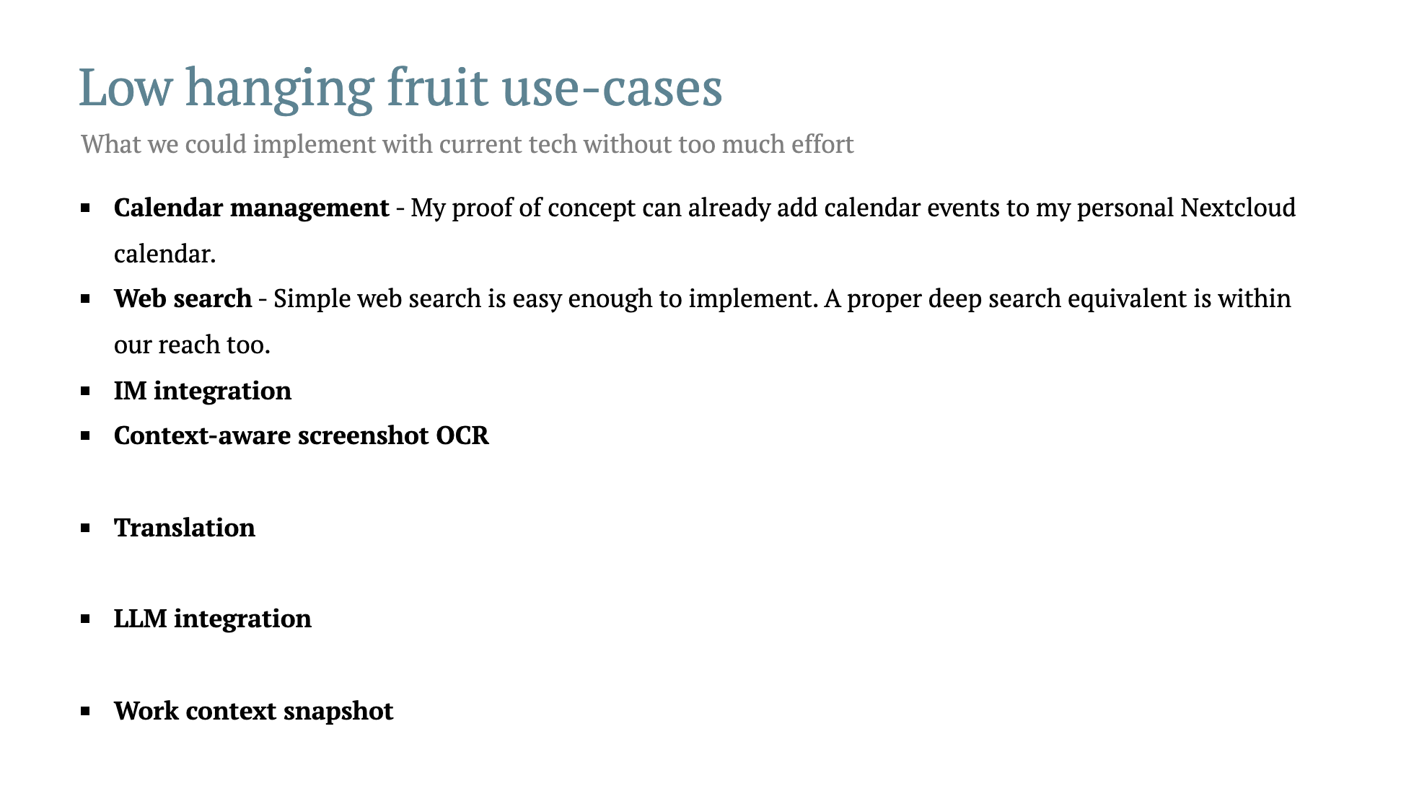

Slide 24
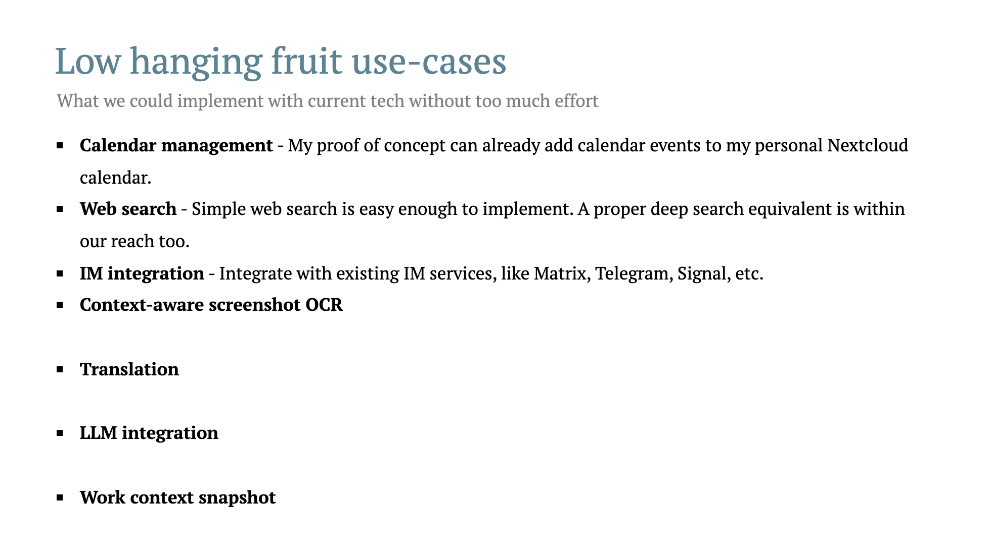

Slide 25
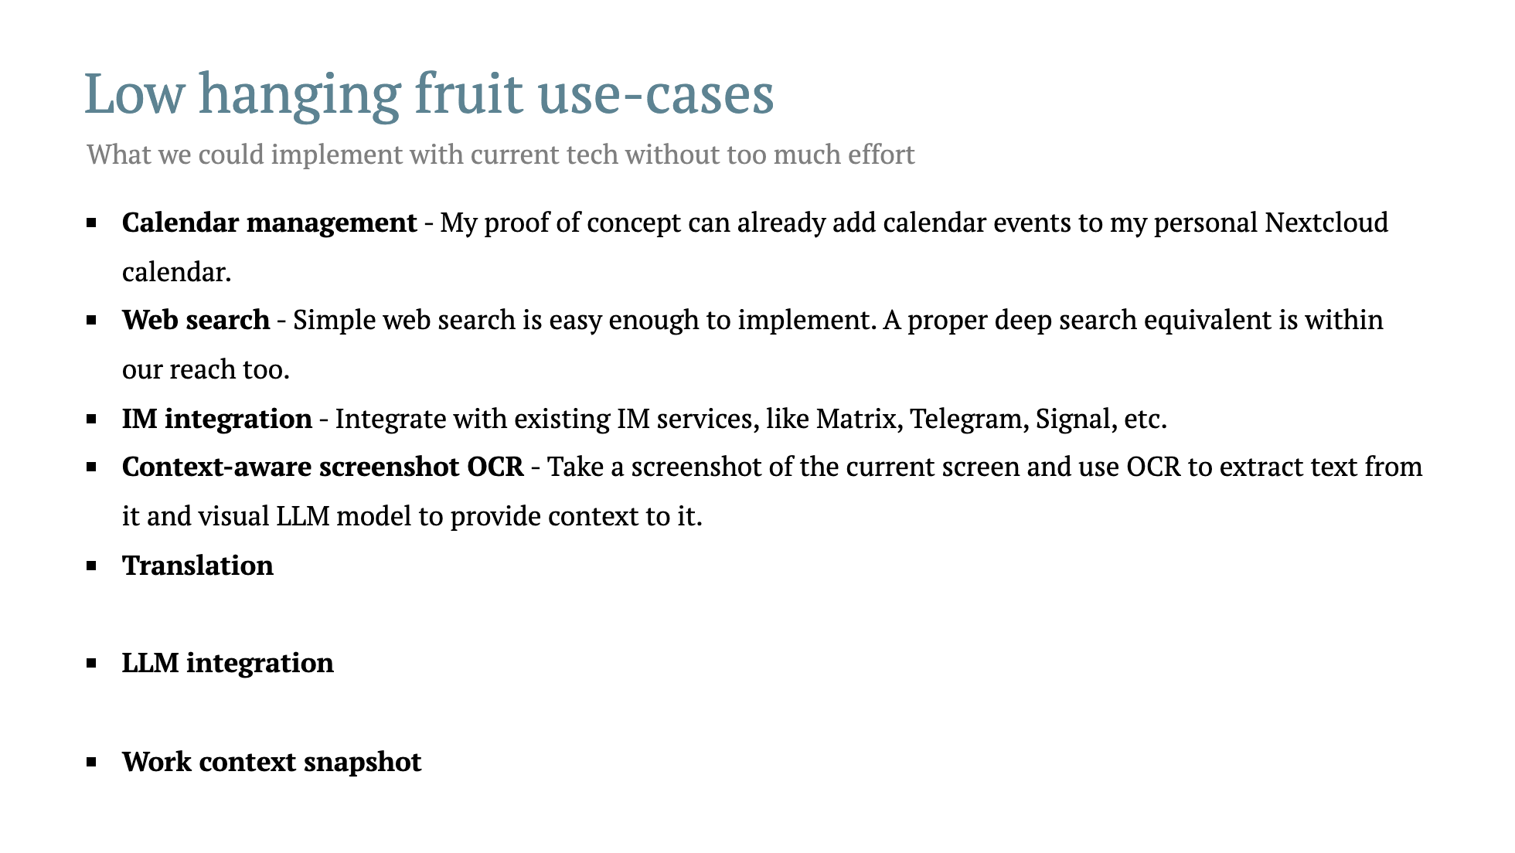

Slide 26
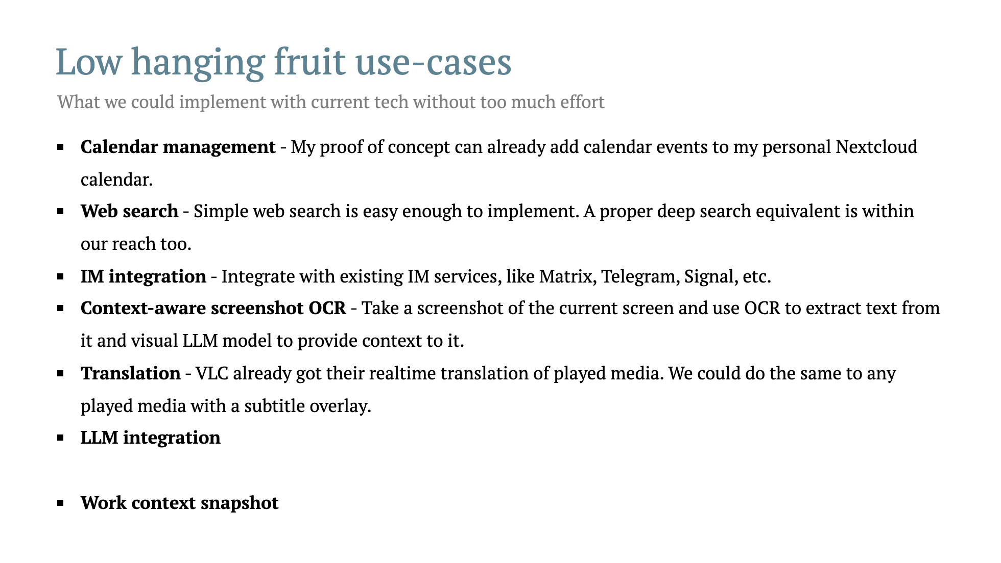

Slide 27
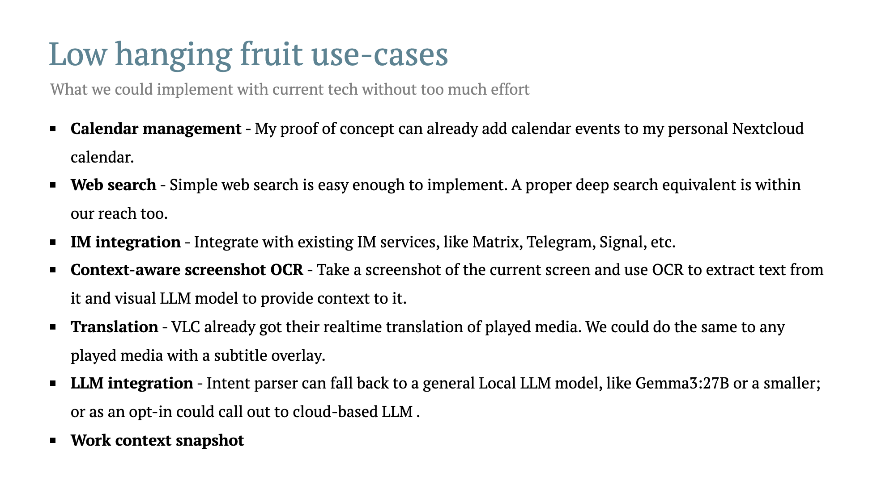

Slide 28
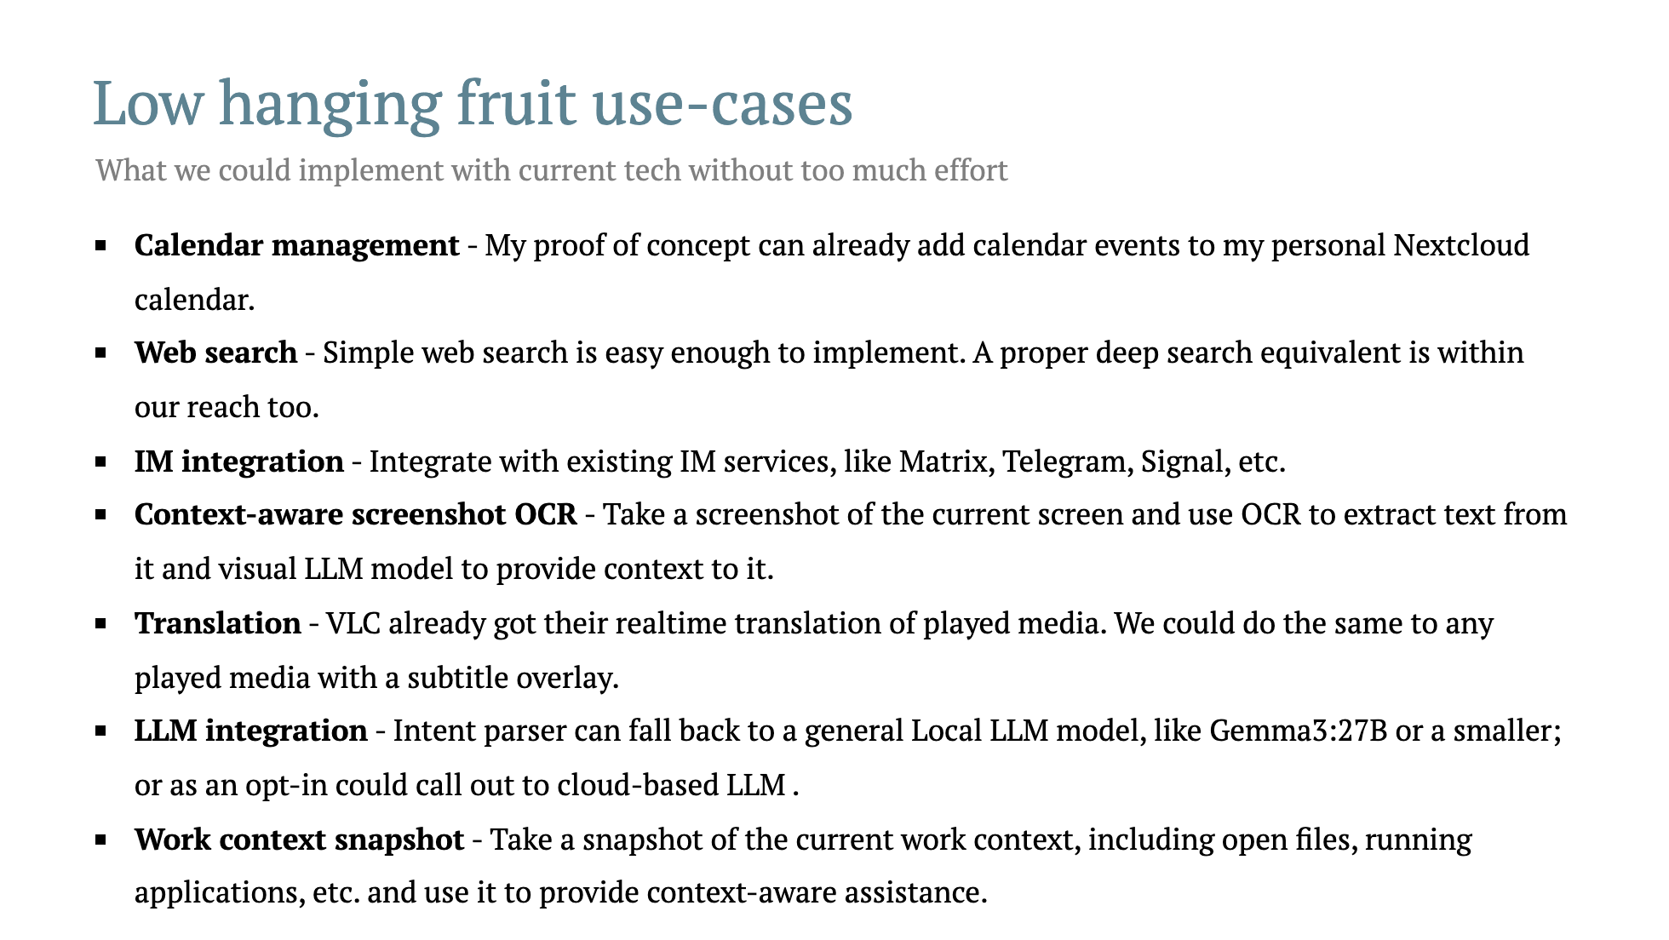

Slide 29
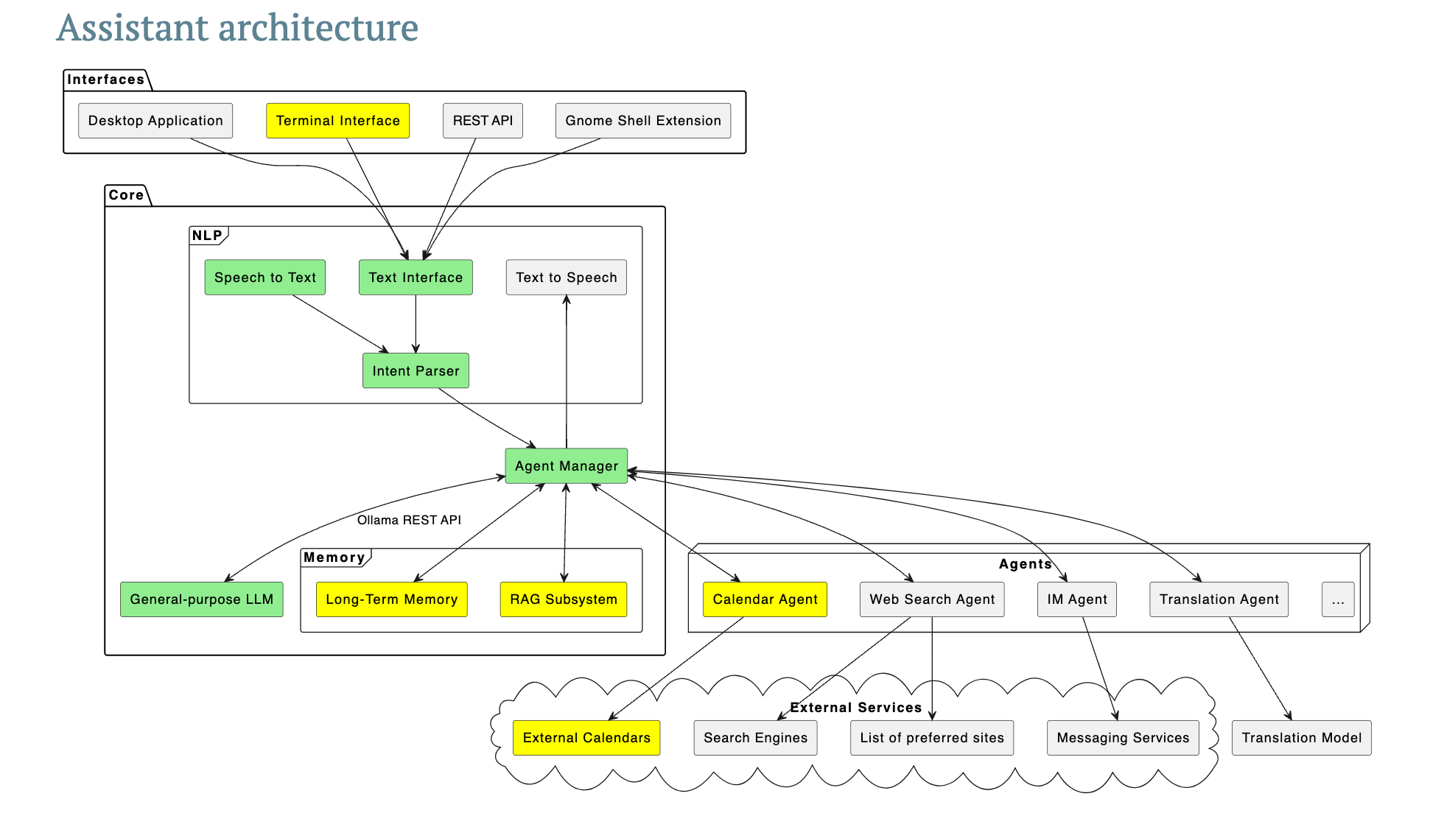

Slide 30
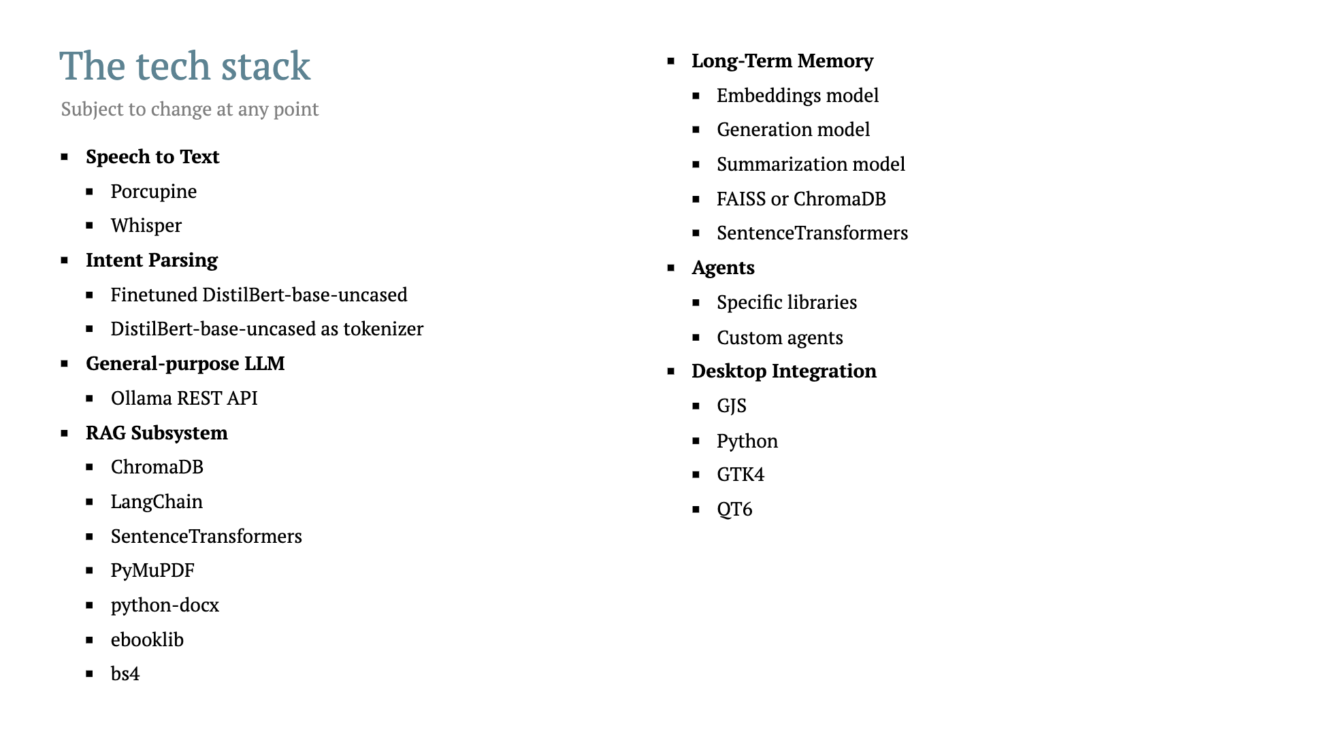

Slide 31
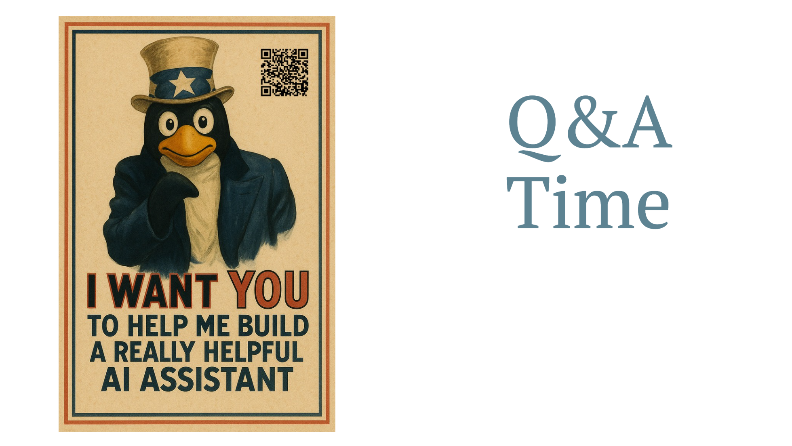

Slide 32
